Slide 1
Target shaft and bearing test
Geunhyeong Lee
07/02/2024

Slide 2
Test plans
Validation the service temperature of the Inconel shaft
Inconel service temperature ~ 650 C (Invar ~ 400C)
Validate the service temperature of the bearing
New bearing service temperature ~ 230 C (Current bearing ~ 150 C)
Understand the thermal behavior of the target by demonstrating a thermal conditions similar to those of the actual system
For the details: N:\songj\2024_target_spindle_offline_test

Slide 3
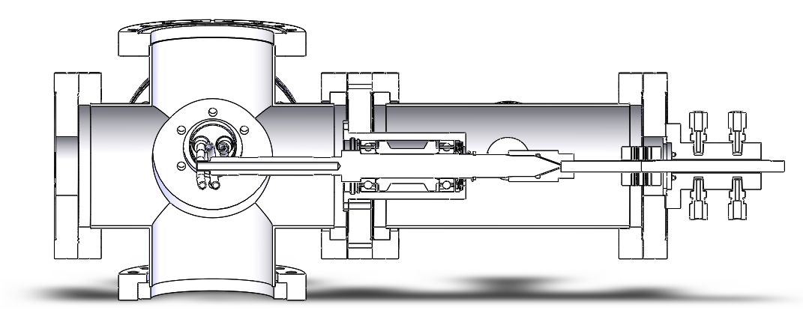
Overview
Water cooling
Thermocouple
Motor, rotation
Vacuum
Coil, heating
Thermal camera
Thermal camera

Slide 4
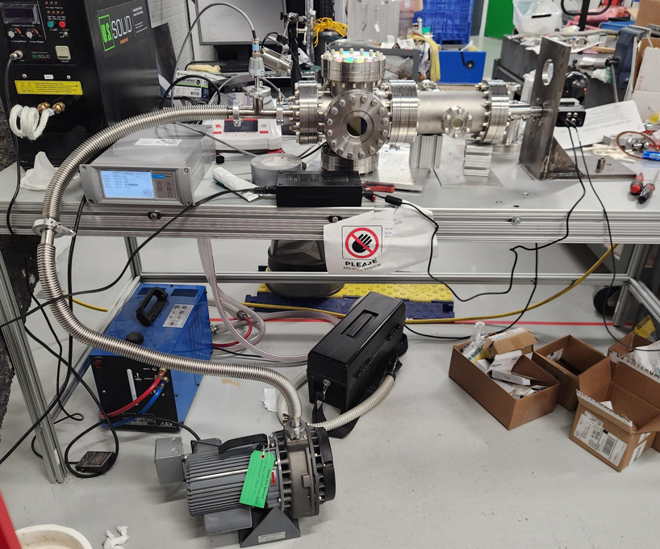
Experiment procedure
Setup
Preparing the components
Base structures (Vacuum chamber, flanges, motor, …)
Water cooling components
Coil development
Assemble the structures
Assemble the flanges and shaft
Connected the motor to the vacuum chamber
by adjusting the height
Coil assemble
Water cooling loop system
Thermal camera and thermocouple
DAQ system
Verify the rotational speed (~500 rpm)
Motor current, temperature (estimate the friction)
File save
* Color indicate : done

Slide 5
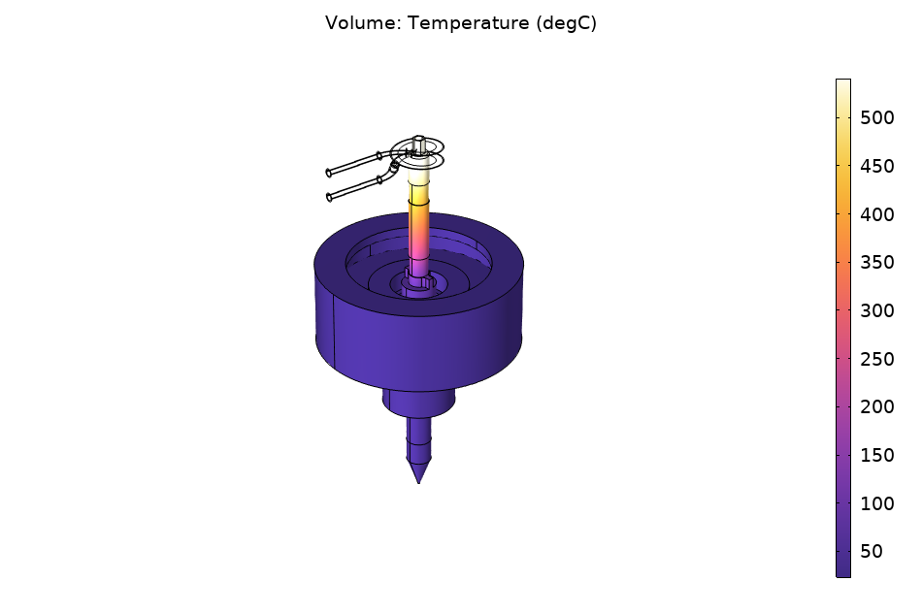
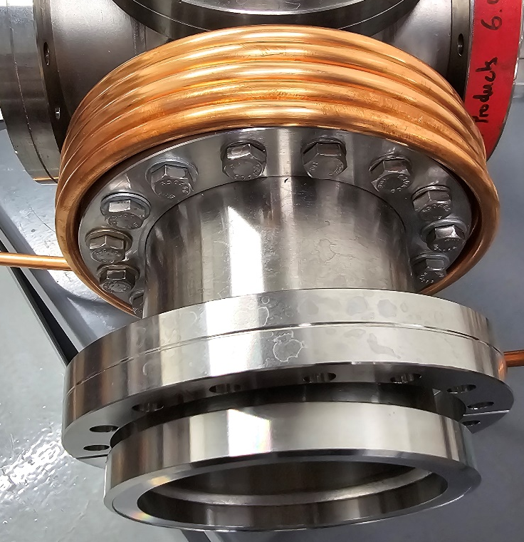
Experiment procedure
Pre-test
Vacuum test
5e-3 torr for 1 hr running
Rotating test
Cooling loop test
Cooling water loop test with flowmeter
Calibration
IR camera temperature calibration
Literature study
Calibration at the system
Simulation
Basic thermal simulation
Current input of coil
Cooling behavior according to the flowrates
Variable changes to know the trend of temperatures
Experiment (Plan: during the July)

